Slide 1

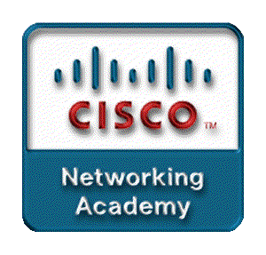
Chapter 4
Network Security
Part II

Slide 2
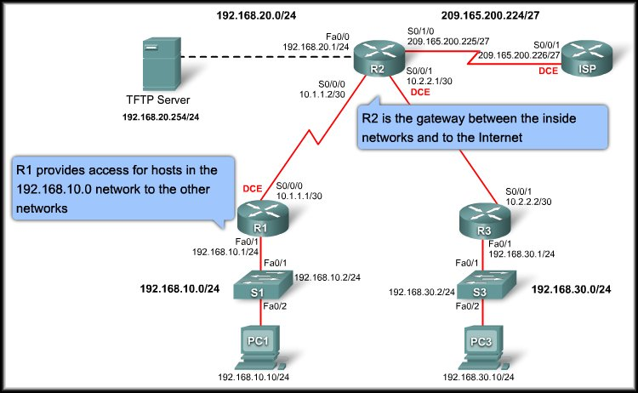
Introducing Network Security
Securing Cisco Routers

Slide 3
Router Security Issues
The Role of Routers in Network Security:
  Router security is a critical element in any security deployment and are definite targets for network attackers.
  Roles:
    Advertise networks and filter who can use them.
    Provide access to network segments and subnetworks.

Slide 4
Router Security Issues
Routers Are Targets:
  Compromising the access control can expose network configuration details, thereby facilitating attacks against other network components.
  Compromising the route tables can reduce performance, deny network communication services, and expose sensitive data.
  Misconfiguring a router traffic filter can expose internal network components to scans and attacks, making it easier for attackers to avoid detection.

Slide 5
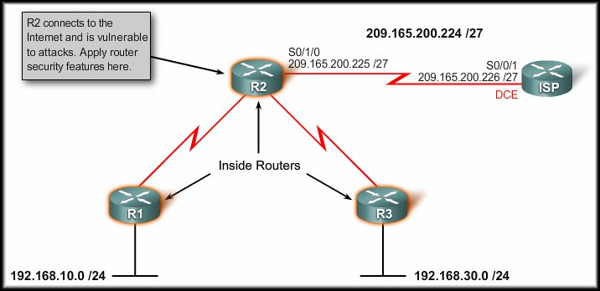
Router Security Issues
Securing routers at the network perimeter is an important first step in securing the network.

Slide 6
Router Security Issues
Securing Your Network:
  Physical:
    Locate the router in a
    locked room that is
    accessible only to authorized personnel.
    UPS.
  Update the router IOS:
    Note that the latest version of an operating system may not be the most stable version available.
    Use the latest, stable release that meets the feature requirements of your network.

Slide 7
Router Security Issues
Securing Your Network:
  Configuration and IOS:
    Keep a secure copy
    of the router IOS and
    router configuration file on a TFTP server for backup purposes.
  Unused Services:
    A router has many services enabled by default.
    Harden your router configuration by disabling unnecessary services and unused ports.

Slide 8
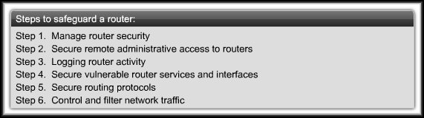
Applying Cisco IOS Security Features
Steps to safeguard a router:

Slide 9
Steps to Safeguard a Router
Step 1: Manage Router Security.
  Basic router security consists of configuring passwords.
  A strong password is the most fundamental element in controlling secure access to a router.
  Follow accepted password practices.
      Don’t write it down.
      Avoid dictionary words.
      Combine letters, numbers and symbols.
      Make password lengthy.
      Change passwords frequently.
The command no password on vty lines prevents any login.

Slide 10
Steps to Safeguard a Router
Step 1: Manage Router Security.
  By default, Cisco IOS software leaves passwords in plain text when they are entered on a router.
    service password-encryption
    enable secret 2ManY-routEs
    security passwords min-length 10

Slide 11
Steps to Safeguard a Router
Step 2: Secure Remote Administrative Access.
  Local access through the console port is the preferred way for an administrator to connect to a device to manage it because it is secure.
  Remote administrative access is more convenient than local access.
  Using Telnet can be very insecure because all network traffic is in plain text.
  An attacker could capture network traffic and sniff the administrator passwords or router configuration.

Slide 12
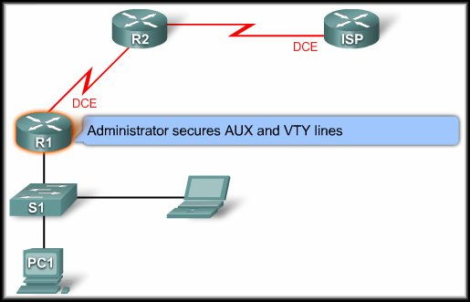
Steps to Safeguard a Router
Step 2: Secure Remote Administrative Access.
  Remote access typically involves allowing Telnet, Secure Shell (SSH), HTTP, HTTP Secure (HTTPS), or SNMP connections to the router from a computer.
  Establish a dedicated
  management network.
  Secure the administrative
  lines.
  Encrypt all traffic between
  the administrator
  computer and the router.

Slide 13
Steps to Safeguard a Router
Step 2: Secure Remote Administrative Access.
  Logins may be prevented on any line by configuring the router with the login and no password commands.
  VTY lines should be configured to accept connections only with the protocols actually needed.
    transport input telnet – only telnet
    transport input telnet ssh – telnet or ssh
  Implement Access Control Lists (ACLs) - Chapter 5.
  Configure VTY timeouts using the exec-timeout command.

Slide 14
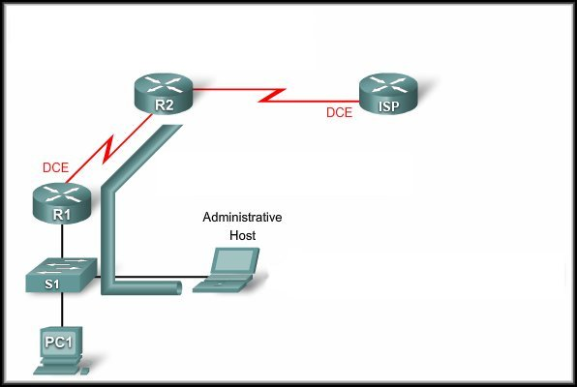



Steps to Safeguard a Router
Step 2: Secure Remote Administrative Access.
SSH Uses TCP Port 22

Slide 15
Configuring SSH Security
To enable SSH, the following parameters must be configured:
    Hostname
    Domain Name
    Asymmetrical Keys
    Local Authentication

Slide 16
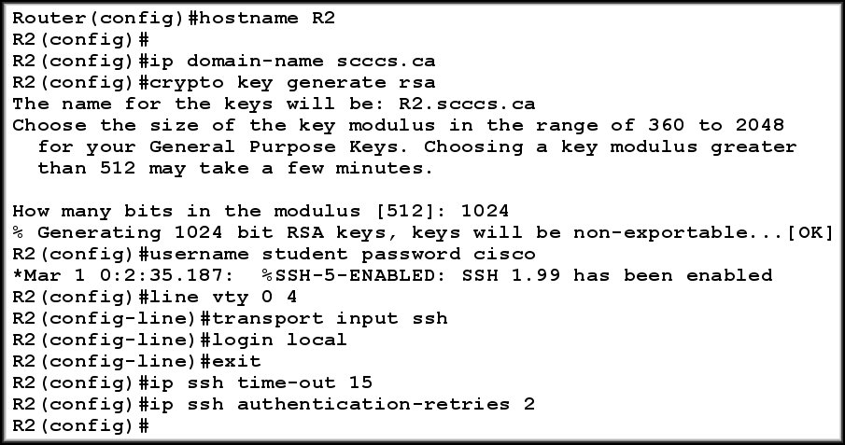
Configuring SSH Security
To enable SSH, the following parameters must be configured:

Slide 17


Configuring SSH Security
To enable SSH, the following parameters must be configured:
    Step 1: Hostname:
    Step 2: Domain Name:
      Required for SSH.

Slide 18
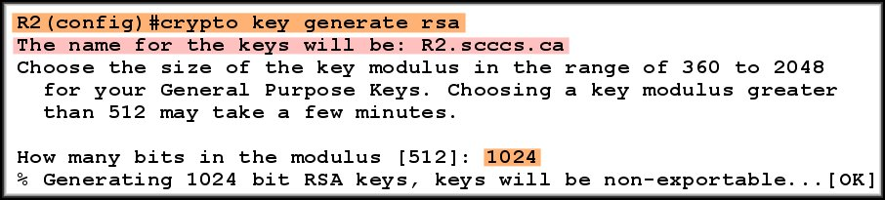
Configuring SSH Security
To enable SSH, the following parameters must be configured:
    Step 3: Generate the RSA key:
      This step creates an asymmetrical key that router uses to encrypt the SSH management traffic.
Cisco recommends a modulus length of 1024. A longer length generates a more secure key but adds some latency.

Slide 19

Configuring SSH Security
To enable SSH, the following parameters must be configured:
    Step 4: Configure local authentication and vty:
      You must define a local user.
      Use the login local command to search the local database and assign ssh to the vty lines.
Makes SSH the only method.
NO TELNET

Slide 20

Configuring SSH Security
To enable SSH, the following parameters must be configured:
    Step 5: Configure SSH timeouts:
      Not absolutely necessary for SSH but probably a good idea.

Slide 21
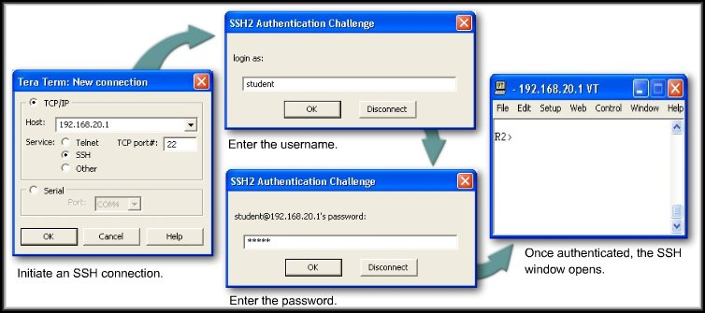
Test SSH Security
To connect to a router configured with SSH, you have to use an SSH client application such as PuTTY or TeraTerm.
  Choose the SSH option and use TCP port 22.

Slide 22
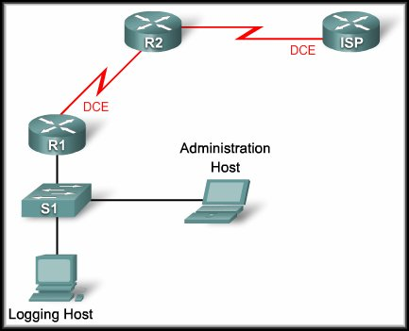
Steps to Safeguard a Router
Step 3: Log Router Activity.
  Logs allow you to verify router is working properly.
  Routers support 8 levels of logging.
    The most important thing to remember about logging is that logs must be reviewed regularly.
0: Emergencies
1: Alerts
2: Critical
3: Errors
4: Warnings
5: Notification
6: Informational
7: Debugging

Slide 23
Steps to Safeguard a Router
Step 4: Securing Router Network Services.
  Cisco routers support a large number of network services at layers 2, 3, 4, and 7.
    Some of them are application layer protocols.
    Others are automatic processes and settings intended to support legacy configurations that pose security risks.
  Some of these services can be restricted or disabled to improve security without degrading the operational use of the router.
    Most of the services listed in this section are usually not required.

Slide 24
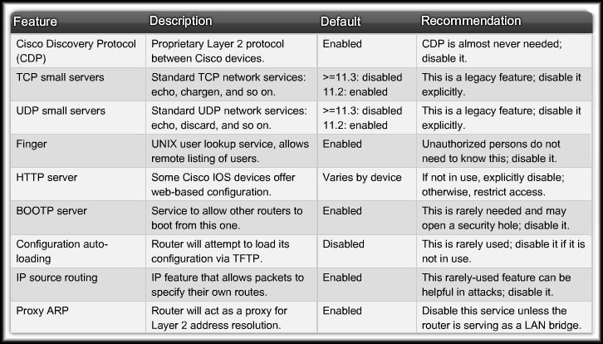
Steps to Safeguard a Router

Slide 25
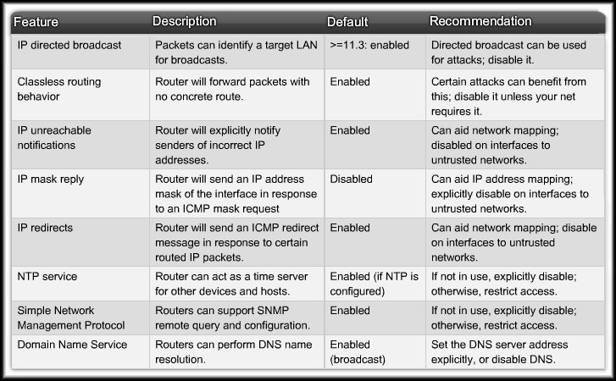
Steps to Safeguard a Router

Slide 26
Steps to Safeguard a Router
Step 4: Securing Router Network Services.
  Turning off a service on the router itself does not mean that the service or protocol cannot be used on the network.
    For example:
      TFTP (Trivial File Transfer Protocol)
      DHCP (Dynamic Host Configuration Protocol)
  Turning off an automatic network feature usually prevents a certain type of network traffic.
    For example:
      IP Source Routing is rarely used but can be used in network attacks.

Slide 27
Steps to Safeguard a Router
Step 4: Securing Router Network Services.
  SNMP, NTP and DNS Vulnerabilities:
    SNMP (Simple Network Management Protocol):
      SNMP is the standard Internet protocol for automated remote monitoring and administration.
      Versions of SNMP prior to Version 3 shuttle information in clear text.

Slide 28
Steps to Safeguard a Router
Step 4: Securing Router Network Services.
  SNMP, NTP and DNS Vulnerabilities:
    NTP (Network Time Protocol):
      Cisco routers and other hosts use NTP to keep their time-of-day clocks accurate.
      Network administrators should configure all routers as part of an NTP hierarchy.
        One router is the master timer and provides its time to other routers on the network.
        If an NTP hierarchy is not available on the network, you should disable NTP.

Slide 29
Steps to Safeguard a Router
Step 4: Securing Router Network Services.
  SNMP, NTP and DNS Vulnerabilities:
    DNS (Domain Name System):
      Cisco IOS software supports looking up hostnames with the Domain Name System (DNS).
      The basic DNS protocol offers no authentication or integrity assurance. By default, name queries are sent to the broadcast address 255.255.255.255.
      Either explicitly set the name server addresses using the global configuration command ip name-server addresses or turn off DNS name resolution with the no ip domain-lookup command.

Slide 30
Steps to Safeguard a Router
Step 5: Securing Routing Protocols.
  Routing systems can be attacked in 2 ways:
    Disruption of peers:
      It is the less critical of the two attacks because routing protocols heal themselves.
    Falsification of routing information:
      Falsified routing information may generally be used to cause systems to misinform (lie to) each other, cause a DoS, or cause traffic to follow a path it would not normally follow.

Slide 31
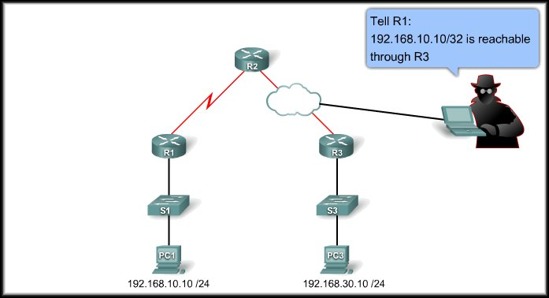
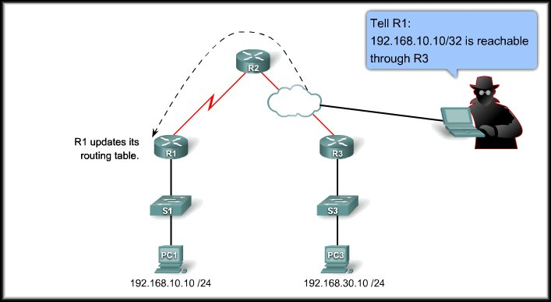
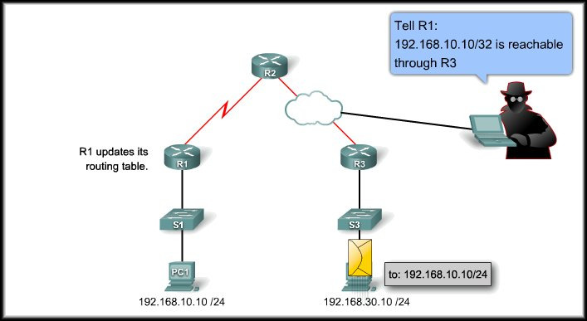
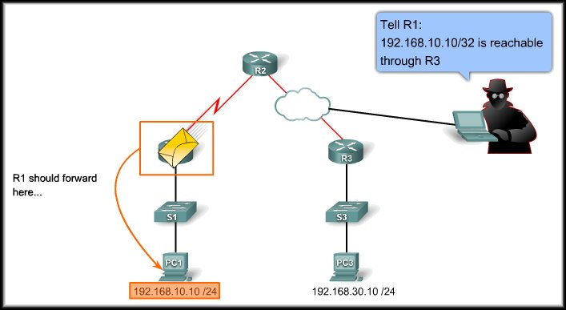
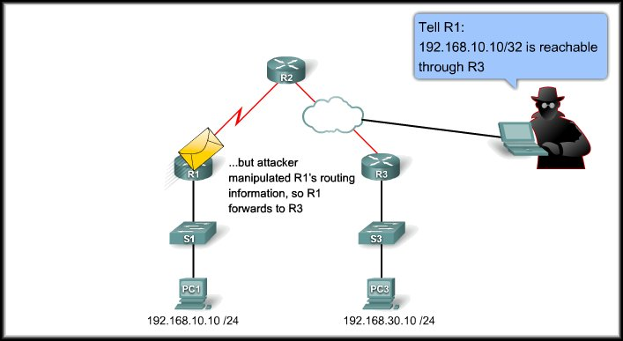
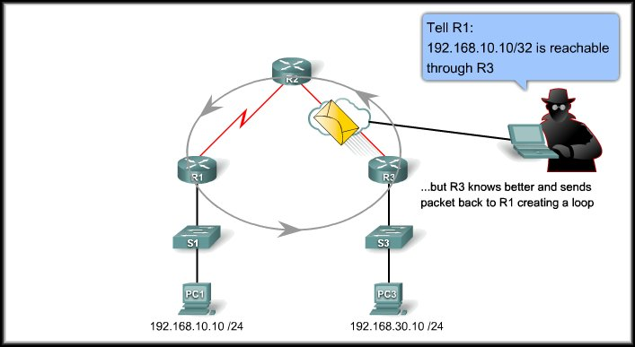
Steps to Safeguard a Router
Step 5: Securing Routing Protocols.
    Falsification of routing information:
Continuous Loop

Slide 32
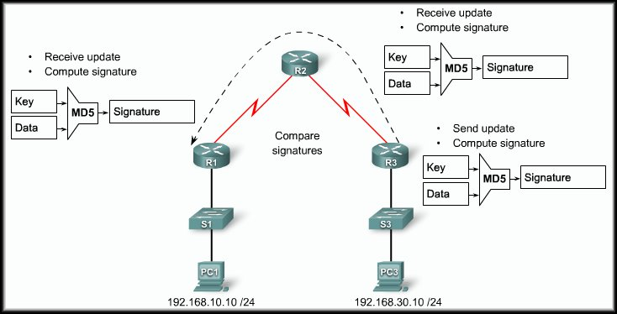
Steps to Safeguard a Router
Step 5: Securing Routing Protocols.
  Protect routing information using message digest algorithm 5 (MD5). Routers compare signatures.
Routing Updates Authenticated

Slide 33
Steps to Safeguard a Router
Step 5: Securing Routing Protocols.
  RIPv2, EIGRP, OSPF, IS-IS, and BGP all support various forms of MD5 authentication.
  For Example:
    Prevent RIP updates from being propagated out ports where there is no other router.
      passive interface command.
    Prevent unauthorized reception of RIP updates by implementing MD5 authentication with a specific key.
    Verify RIP routing.
  While the commands are different, the same basic process is used for other protocols.

Slide 34
Steps to Safeguard a Router
Locking Down Your Router With Cisco Auto Secure:
  Cisco AutoSecure uses a single command to disable non-essential system processes and services.
  Configure it in privileged EXEC mode using the auto secure command in one of these two modes:
  Interactive mode:
    This mode prompts you with options to enable and disable services and other security features. (default)
  Non-interactive mode:
    Automatically executes the auto secure command with the recommended Cisco default settings.

Slide 35
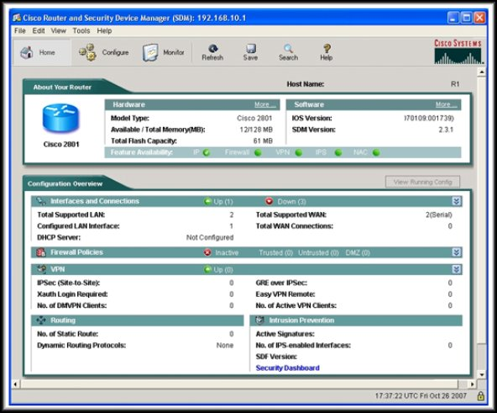
Introducing Network Security
Using Cisco SDM

Slide 36
Using Cisco SDM
Cisco SDM Overview:
  The Cisco Security Device Manager (SDM) is a web-based device management tool designed for configuring LAN, WAN, and security features on Cisco IOS software-based routers.
    It provides:
      Easy-to-use smart wizards.
      Automates router security management.
      Assists through comprehensive online help.

Slide 37
Using Cisco SDM
Cisco SDM Overview:
  Cisco SDM ships preinstalled by default on all new Cisco integrated services routers.
    If it is not preinstalled, you will have to install it.
    If SDM is pre-installed, Cisco recommends using Cisco SDM to perform the initial configuration
  SDM files can be installed on router, PC, or both.
    An advantage of installing SDM on the PC is that it saves router memory, and allows you to use SDM to manage other routers on the network.

Slide 38
Using Cisco SDM
Configuring Your Router to Support SDM:
  Before you can install SDM on an operational router, you must ensure that a few configuration settings are present in the router configuration file.
    Access the router's Cisco CLI interface using Telnet or the console connection.
    Enable the HTTP and HTTPS servers on the router
    Create a user account defined with privilege level 15.
    Configure SSH and Telnet for local login and privilege level 15.

Slide 39
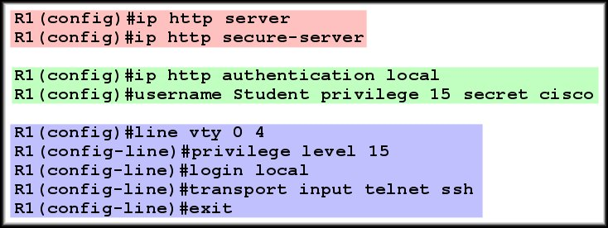
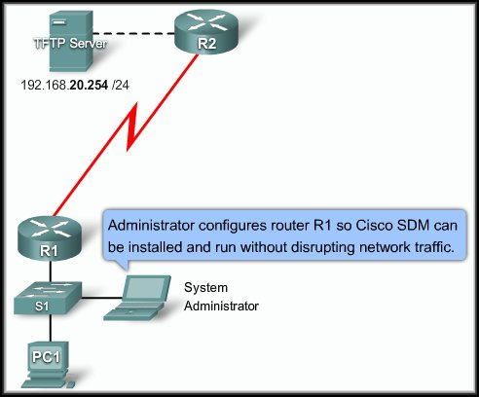
Using Cisco SDM
HTTP and HTTPS
Generates 1024 bit RSA keys
Configuring Your Router to Support SDM:
User Account
SSH and Telnet

Slide 40
Using Cisco SDM
Starting SDM:
  To launch the Cisco SDM use the HTTPS protocol and put the IP address of the router into the browser.
  When the username and password dialog box appears, enter a username and password for the privileged (privilege level 15) account on the router.
  After the launch page appears a signed Cisco SDM Java applet appears which must remain open while Cisco SDM is running.
  Because it is a signed Cisco SDM Java applet you may be prompted to accept a certificate.

Slide 41
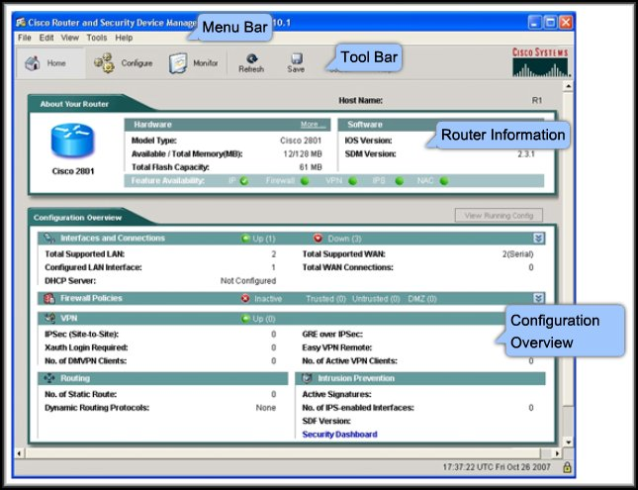
Using Cisco SDM
More in the Lab

Slide 42
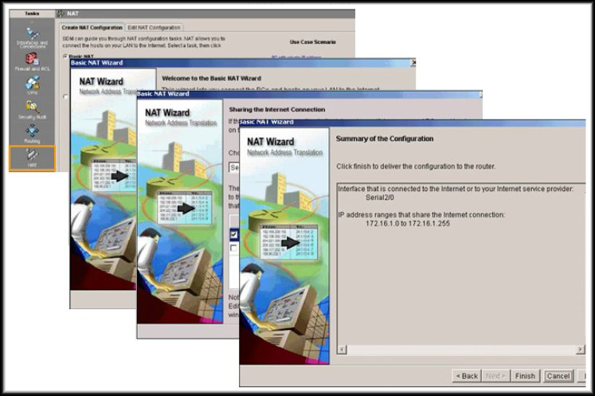
Using Cisco SDM
Cisco SDM Wizards:
More in the Lab

Slide 43
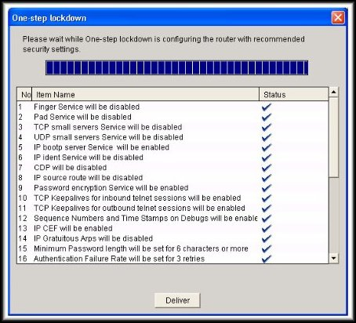
Using Cisco SDM
Locking Down a Router with SDM:
More in the Lab

Slide 44
Introducing Network Security
Secure Router Management

Slide 45
Maintaining Cisco IOS Software Images
There are certain guidelines that you must follow when changing the Cisco IOS software on a router.
    Updates:
      A free update replaces one release with another without upgrading the feature set. (Bug fixes)
    Upgrades:
      An upgrade replaces a release with one that has an upgraded feature set or new technologies.
      Upgrades are not free.

Slide 46
Maintaining Cisco IOS Software Images
It is not always a good idea to upgrade to the latest version of IOS software.
    Many times that release is not stable.
    It may include new features or technologies that are not needed in your enterprise.

Slide 47
Maintaining Cisco IOS Software Images
Cisco recommends a four-phase migration process.
    Plan:
      Set goals, identify resources, profile network hardware and software, and create a schedule for migrating to new releases.
    Design:
      Choose new Cisco IOS releases.
    Implement:
      Schedule and execute the migration.
    Operate:
      Monitor the migration progress and make backup copies of images that are running on your network.

Slide 48
Maintaining Cisco IOS Software Images
There are a number of tools available on Cisco.com to aid in migrating Cisco IOS software.
  Some tools do not require a Cisco.com login:
    Cisco IOS Reference Guide.
    Cisco IOS software technical documents.
    Cisco Feature Navigator.
  Some tools require valid Cisco.com login accounts:
    Download Software.
    Bug Toolkit.
    Software Advisor.
    Cisco IOS Upgrade Planner.
  http://www.cisco.com/en/US/support/tsd_most_requested_tools.html

Slide 49
Managing Cisco IOS Images
Cisco IOS File Systems and Devices:
  Cisco IOS devices provide a feature called the Cisco IOS Integrated File System (IFS).
    The directories available depend on the platform.
    The show file systems command lists all file systems.
    It provides information such as the amount of available and free memory, type of file system and its permissions.
    Permissions include read only (ro), write only (wo), and read and write (rw).

Slide 50
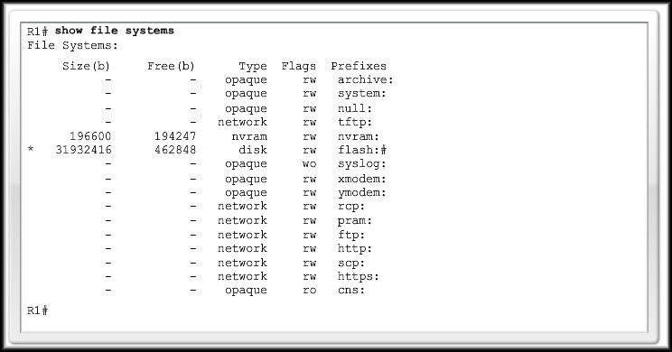
Managing Cisco IOS Images
Cisco IOS File Systems and Devices:
* = current default
# = bootable disk with the current IOS file

Slide 51
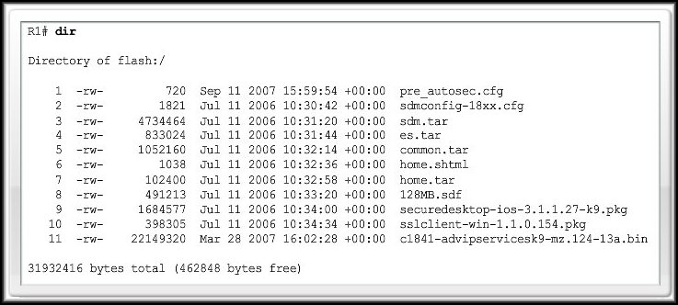
Managing Cisco IOS Images
Cisco IOS File Systems and Devices:
  Flash:

Slide 52
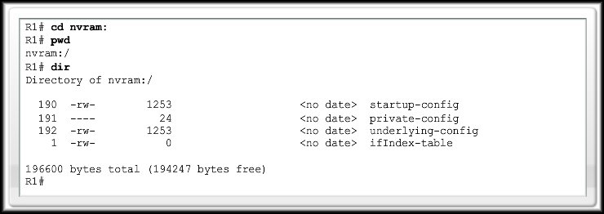
Managing Cisco IOS Images
Cisco IOS File Systems and Devices:
  NVRAM:

Slide 53
Managing Cisco IOS Images
URL Prefixes for Cisco Devices:
  Administrators do not have visual cues when working at a router CLI.
    File locations are specified in Cisco IFS using the URL convention.
    Similar to the format you know from the web.
    For Example:
    tftp://192.168.20.254/configs/backup-configs
Prefix
Server master folder
Backup
file name
IP Address of the TFTP Server

Slide 54
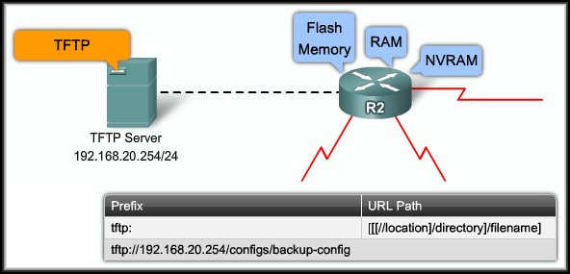
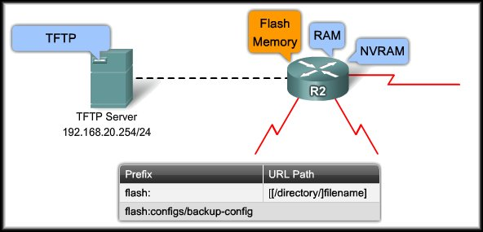
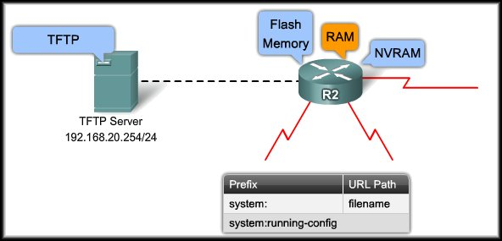
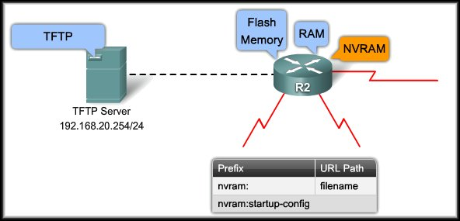
Managing Cisco IOS Images
URL Prefixes for Cisco Devices:

Slide 55
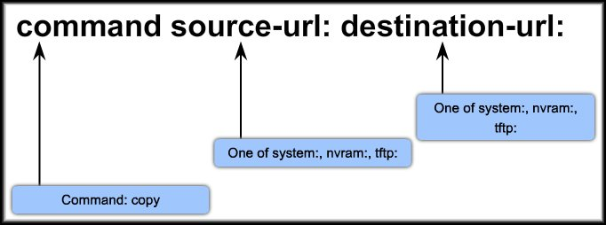
Managing Cisco IOS Images
URL Prefixes for Cisco Devices:
  The copy command is used to move files from one device to another, such as RAM, NVRAM, or a TFTP server.

Slide 56
Managing Cisco IOS Images
URL Prefixes for Cisco Devices:
  The copy command is used to move files from one device to another, such as RAM, NVRAM, or a TFTP server.
  R2#copy run start
  R2#copy system:running-config nvram:startup-config
  R2#copy run tftp:
  R2#copy system:running-config tftp:
  R2#copy tftp: start
  R2#copy tftp: nvram:startup-config

Slide 57
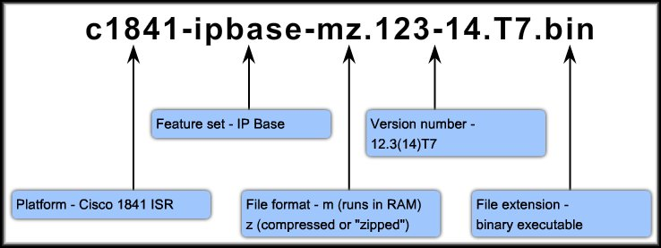
Managing Cisco IOS Images
Cisco IOS File Naming Conventions:
  The IOS image file is based on a special naming convention that contains multiple parts, each with a specific meaning.

Slide 58
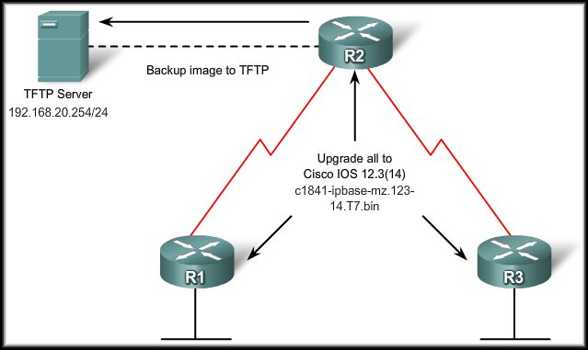
TFTP Managed Cisco IOS Images
For any network, it is always prudent to retain a backup copy of the IOS image in case the image in the router becomes corrupted or accidentally erased.
Using a network TFTP server allows image and configuration
uploads and
downloads over
the network.
The TFTP server
can be another
router or a
workstation.

Slide 59
TFTP Managed Cisco IOS Images
Before changing a
Cisco IOS image on
the router, you need
to complete these
tasks:
  Determine the memory required for the update.
  Set up and test the file transfer capability.
  Schedule the required downtime.

Slide 60
TFTP Managed Cisco IOS Images
When you are ready
to do the update:
  Shut down all
  interfaces not
  needed to
  perform the update.
  Back up the current operating system and the current configuration file to a TFTP server.
  Load the update for either the operating system or the configuration file.
  Test to confirm that the update works properly.

Slide 61
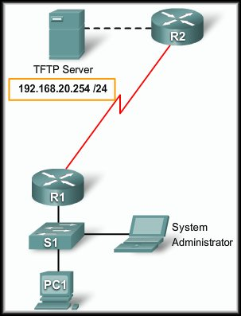
TFTP Managed Cisco IOS Images
To copy IOS image software or any other files from a network device flash drive to a network TFTP server:
  Ping the TFTP server to make
  sure you have access to it.
  Verify that the TFTP server has
  sufficient disk space.
  Use the show flash:command
  to determine the name of the files.
  Copy the file(s) from the router
  to the TFTP server using the
  copy flash: tftp: command.
    Each file requires a separate
    command.

Slide 62
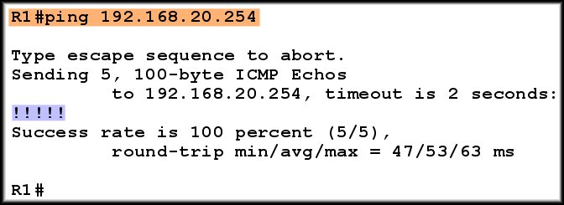
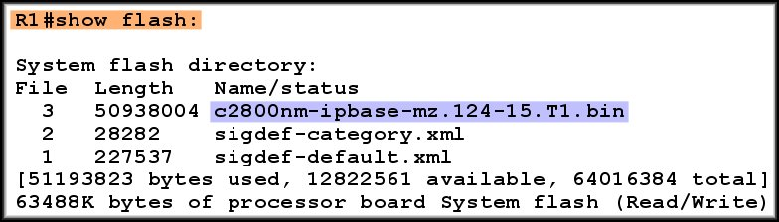
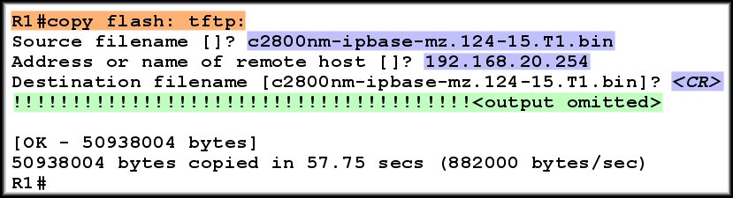
TFTP Managed Cisco IOS Images

Slide 63
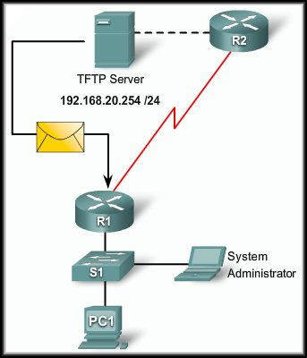
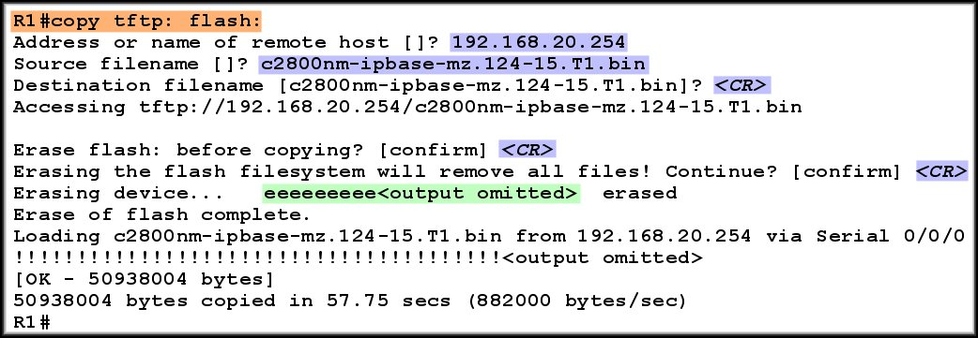
TFTP Managed Cisco IOS Images
Upgrading a system to a newer software version requires a different system image file to be loaded on the router.

Slide 64
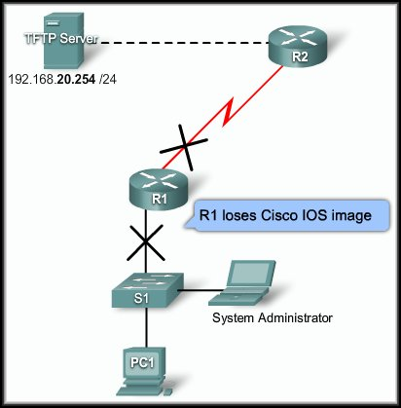
Recovering Software Images
When an IOS on a router is accidentally deleted from flash, the router is still operational because the IOS is running in RAM.
  However, it is crucial that the
  router is not rebooted as a
  production device since
  it would not be able to find a
  valid IOS in flash.
  When the router is rebooted
  and can no longer load an
  IOS it loads in ROMmon
  mode by default.
  prompt = rommon >

Slide 65
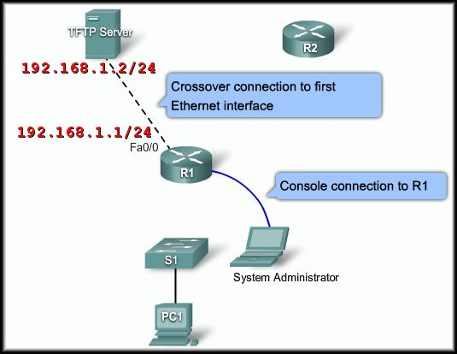
Recovering Software Images
Using tftpdnld:
  Connect a PC to the
  console port.
  Connect the first
  Ethernet port on the
  router to the TFTP
  server with a
  cross-over cable.
  Configure the TFTP
  server with a static IP Address.
  Boot the router and set the ROMmon variables.
  Enter the tftpdnld command.

Slide 66
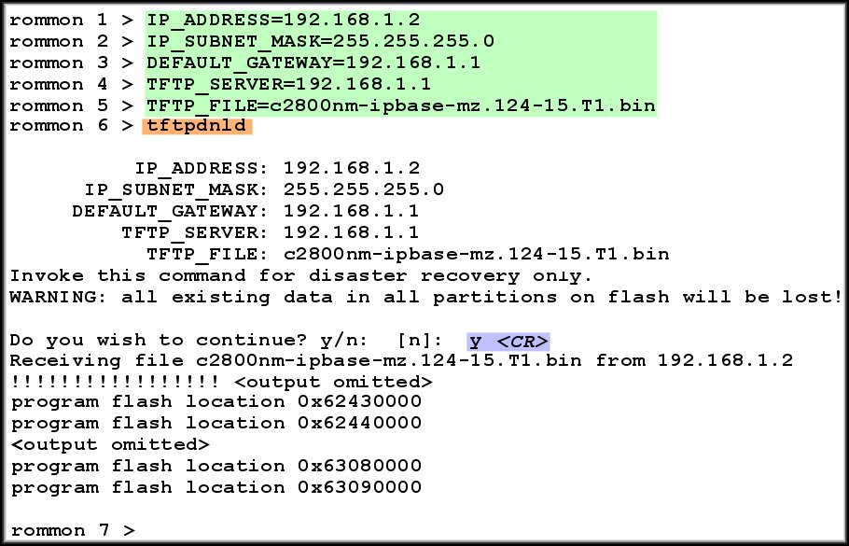
Recovering Software Images
Case Sensitive
Either power cycle the router or use the reset command.

Slide 67
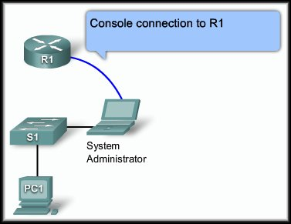
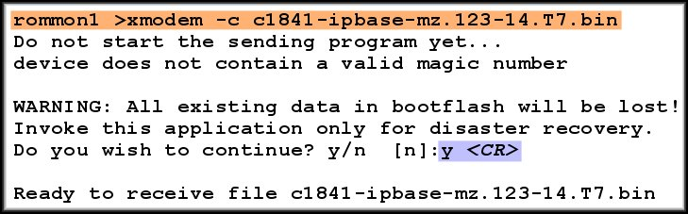
Recovering Software Images
Using xmodem:
  Connect a PC to the
  console port.
  Boot the router and
  issue the xmodem
  command.

Slide 68
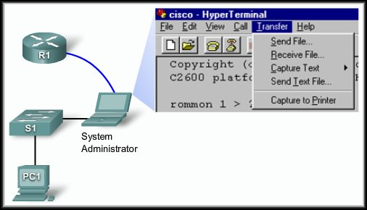
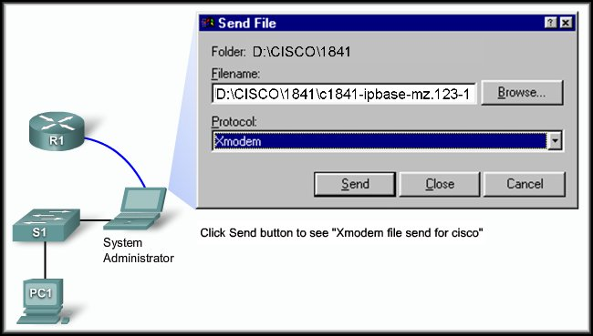
Recovering Software Images
Using xmodem:
  Load a terminal
  emulation program
  (e.g. Hyperterminal)
  that supports the
  Xmodem
  protocol.
  Once the
  transfer has
  finished, reboot
  the router.

Slide 69
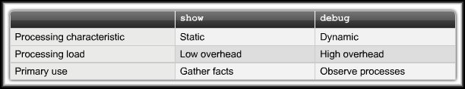
Troubleshooting Cisco IOS Configurations
Cisco IOS troubleshooting commands:
  show – configured parameters and their values.
  debug – trace the execution of a process.
  By default, the router sends the output from debug commands to the console but it can be redirected to a logging server.

Slide 70
Troubleshooting Cisco IOS Configurations
Considerations when using the debug command:
  Plan the use of the debug command. Use it carefully.
  Gets CPU priority and may interfere with normal routing processes.
  Can help resolve network issues even though you may take a temporary performance hit.
  Can generate too much output. Know what you’re looking for before you start.
  Different debugs generate different output. Don’t be caught by surprise.

Slide 71
Recovering a Lost Password
Password Recovery:
  Recovering a password makes use of the router’s configuration register.
  This register is like the BIOS on a PC.
    When a router boots, it will check the register and boot in the manner specified by the value in the register.
  For this course, we will only concern ourselves with two registry values.
    0x2102: the default registry value.
    0x2142: instructs the router to bypass any startup configuration.

Slide 72
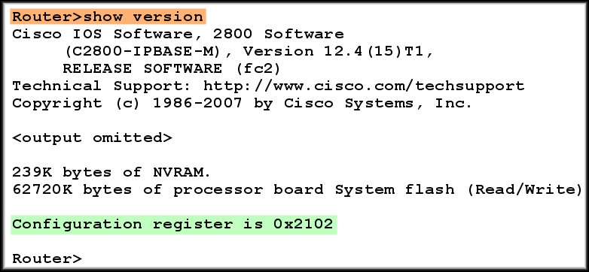
Recovering a Lost Password
Password Recovery Basic Steps:
  Connect to the router console port.
  Issue the show version command to obtain the current registry value.

Slide 73
Recovering a Lost Password
Password Recovery Basic Steps:
  Power cycle the router and press the “Break” key within 60 seconds. This puts the router in ROMmon mode.
  Type confreg 0x2142 at the rommon 1 > prompt to specify bypassing the startup configuration.
  Type reset or power cycle the router.
  Bypass any default startup questions and type enable.
  Copy the start up configuration to the running configuration.

Slide 74
Recovering a Lost Password
Password Recovery Basic Steps:
  Change the password. (enable secret, Console or VTY)
  Change the configuration register back to the default using the following command:
  Router(config)#config-register 0x2102
  Copy the running configuration to the startup configuration and reload or power cycle the router.
We will do this in the lab.

